Slide 1
CHAT-BOT SYSTEM FOR COMPUTERS, ACCESSORIES & REPAIR CENTER RECOMMENDATION
TMP – 23 - 283
Notes:
HOW TO START >>> Give real world example when we try search for a device.
(Good Afternoon All, Let me initiate our presentation asking this particular Q….)
How many hours have you spent searching the internet, asking friends when you are willing to buy a new device? In particular a Laptop, PC accessories or even repair centers.
Personally, as IT enthusiastic this is interesting for us, yet sometimes a hassle. And most definitely, it’s a hassle for who aren’t doesn’t have a IT domain knowledge, isn’t?
THUS:
Hybrid of Chat bot & recommender system for devices, accessories & repair centers.

Slide 2
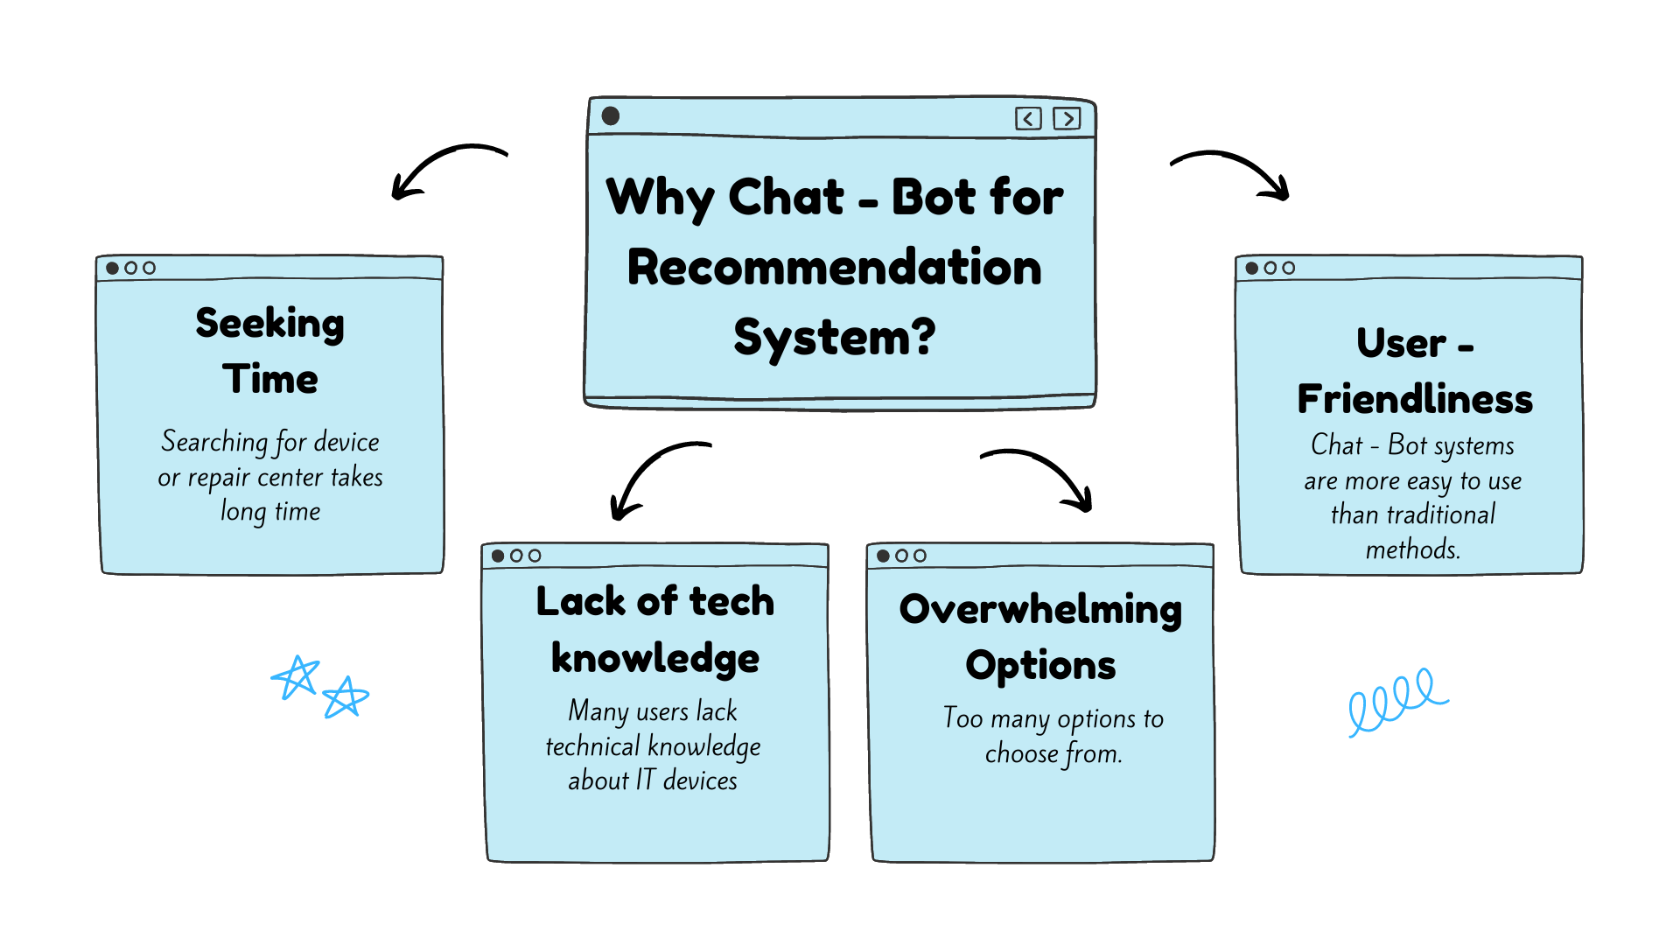
Research Problem
CHAT-BOT SYSTEM FOR COMPUTERS, ACCESSORIES & REPAIR CENTER RECOMMENDATION
Research Problem
Notes:
Identified problems in the real-world scenario: (Reason to implement such system)
Seeking time
Lack of knowledge
Too many options to choose from

Slide 3
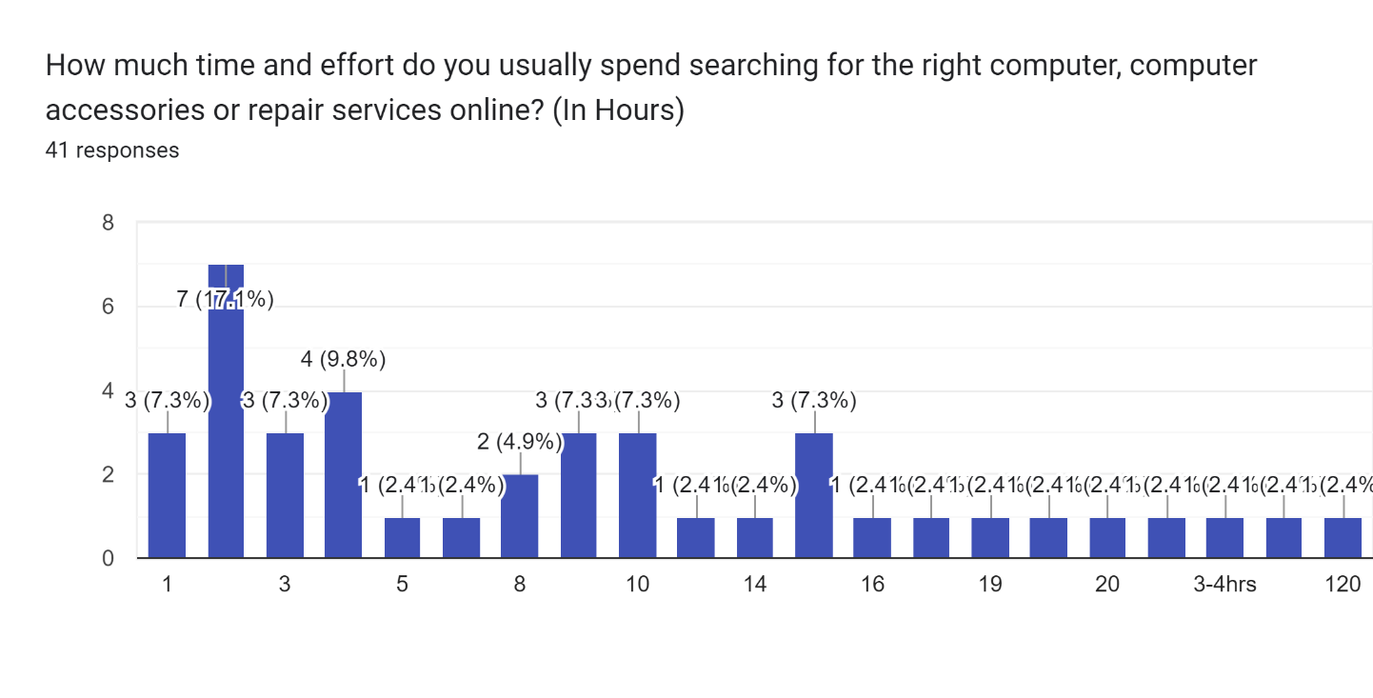

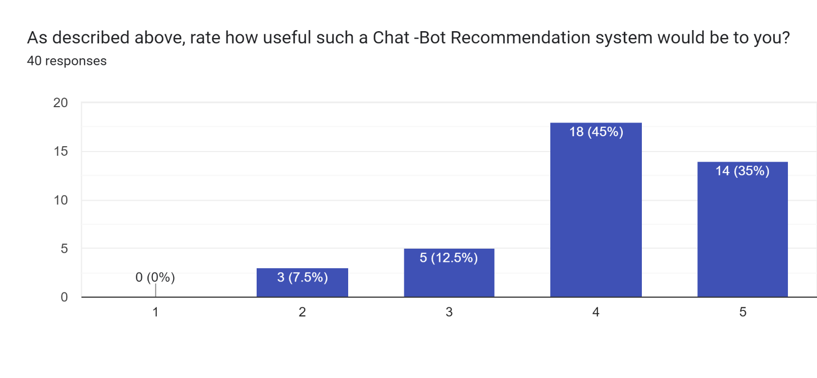
Average 10 Hours spent to search a device
Research shows that Chat-Bot based recommender would be useful:
CHAT-BOT SYSTEM FOR COMPUTERS, ACCESSORIES & REPAIR CENTER RECOMMENDATION
Research Problem
Notes:
From the research we’ve done using a questioner, we were able to find these statistics.

Slide 4

Research Objective
Increase user satisfaction and cater their needs
User needs are determined by a Chat-Bot system using query processing and image processing
Image processing to identify computer accessories & Query processing to identify keywords
CHAT-BOT SYSTEM FOR COMPUTERS, ACCESSORIES & REPAIR CENTER RECOMMENDATION
Research Objective
Notes:
Increase User Satisfaction by introducing a Cha-Bot system.
Identify user needs via Chat-Bot system. (Inputs – Both Query & images)
Using Image processing to identify computer accessories & Query processing to identify keywords.

Slide 5

Research Objective
Recommender system to suggest devices & repair centers based on online reviews & product specification
Web scraping and speech to text system from video reviews to gather data
CHAT-BOT SYSTEM FOR COMPUTERS, ACCESSORIES & REPAIR CENTER RECOMMENDATION
Research Objective
Notes:
Implement state of the art recommender system to recommend devices and repair centers.
Last but not least, using web scraping & speech to text systems to gather info. About devices.

Slide 6
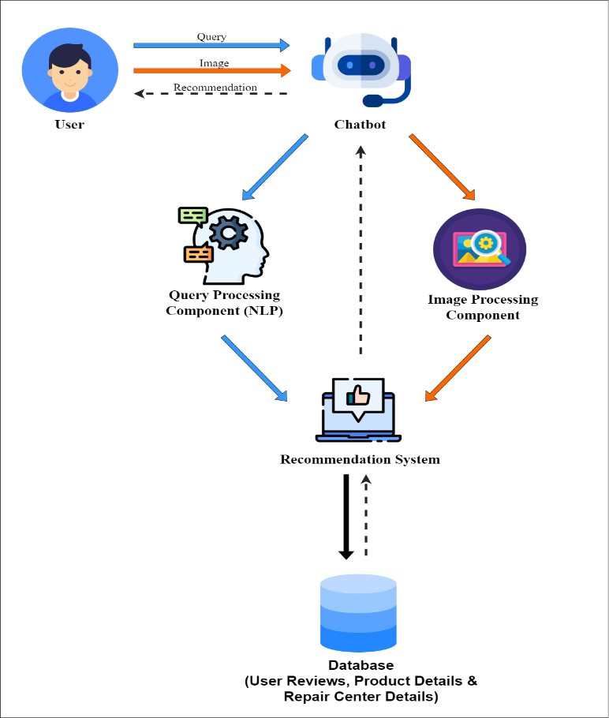
Overall Diagram
CHAT-BOT SYSTEM FOR COMPUTERS, ACCESSORIES & REPAIR CENTER RECOMMENDATION
Overall Diagram
Notes:
High level architecture.
All 4 components of our system are included.
Chat Bot & NLP
Image processing Component
Recommender System
Web Scraping for data gathering & speech to text from video reviews.
My colleagues & I will dive into specifics in the individual components.

Slide 7
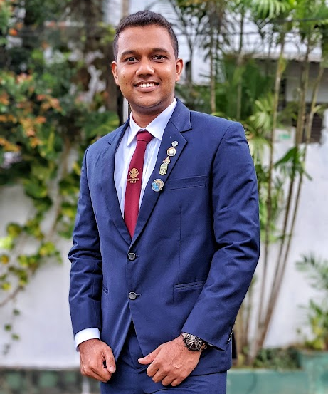
IT20225506 | Thirimanne S.U
B.Sc. (Hons) Degree in Information Technology Specialized in Data Science
IT20225506 | THIRIMANNE S.U | TMP – 23 – 283

Slide 8
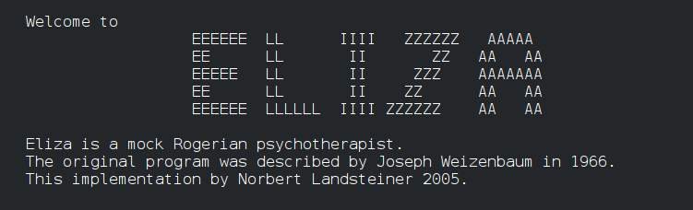
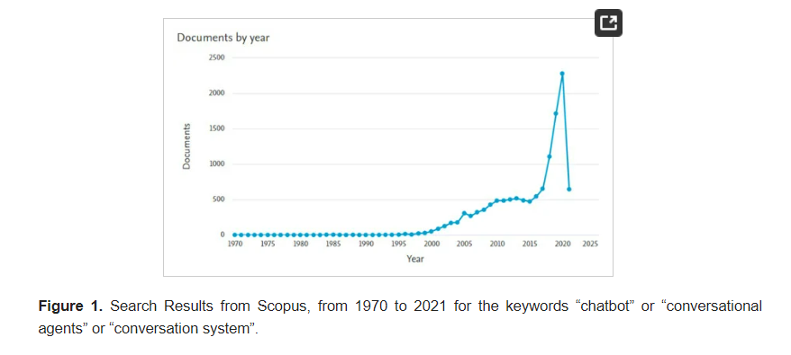
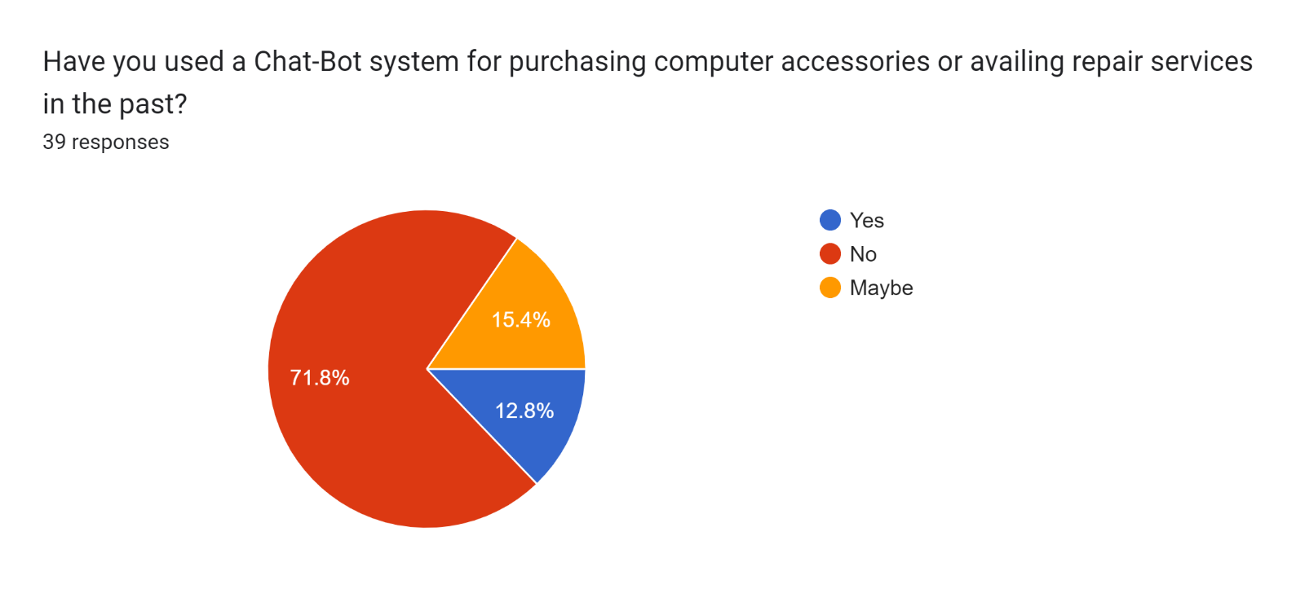
Background & Research Question – Why Chat-Bot System?
Improve the human touch.[1]
Easy to use with any domain
knowledge.
State of the art system
IT20225506 | THIRIMANNE S.U | TMP – 23 – 283
Notes:
>>>> When a user enters our system initially, first thing they interact is the Chat-Bot component. Lets see why we have chosen Chat-Bot systems to interact with the user.
SO, As the world gets rapidly digitized, we tend to lose the human touch in every aspects. Thus, Chat-Bot systems.
ELIZA first chatbot(a natural language processing computer) in 1996. Thus, to mimic the human nature we move towards Chat-Bot based systems. As in this literature survey of recent advances in chatbots, we can observe developers tend to move more towards to chatbots.
No need expertise knowledge in IT or whatsoever.
As of the questioner we shared, more than 70% haven’t used such a system. Thus, this system would obviously be a state-of the art system.

Slide 9
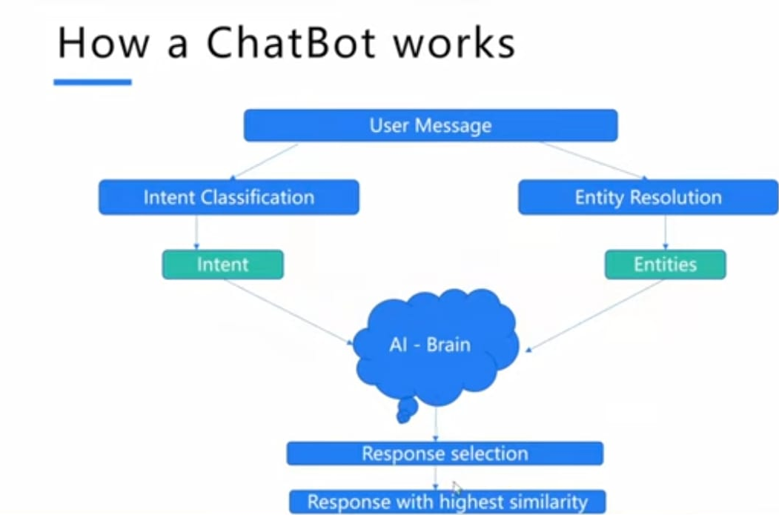
How Chat-Bot Systems Work
IT20225506 | THIRIMANNE S.U | TMP – 23 – 283
Notes:
Intent> HI
Entity> Objects, People
HI, Recommend me a computer?

Slide 10
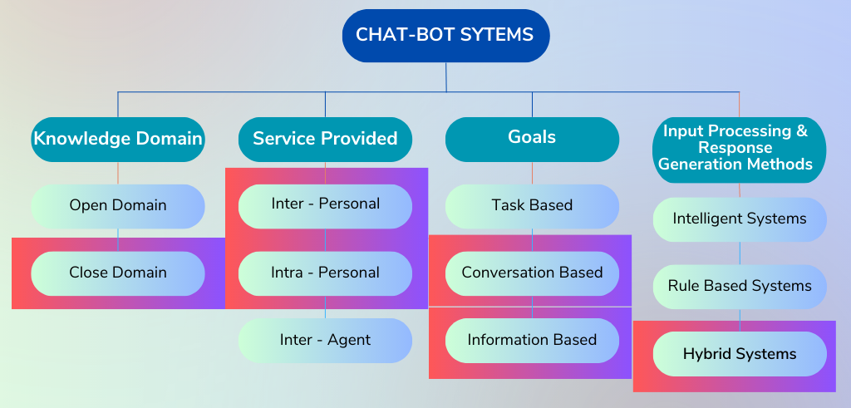
Types of Chat-Bot Systems [2]
IT20225506 | THIRIMANNE S.U | TMP – 23 – 283
Notes:
Open > not specified, it has wide variety of domain knowledge.
Close > specified to a certain knowledge. (OUR System)
Inter > Provide service without being a companion of the user
Intra > Provide service by being a companion of the user (Alexa)
Inter Agent > IOT dominant, two systems communicate to accomplish a task
Task Based > Perform certain task like booking a flight
Conversational > Mimic a conversation with a human
Informative > designed to provide info. That’s stored.
Intelligent System >Generate response using AI (Best when domain is narrow)
Rule Based > Set of coded rules (Ask particular Q to identify user need)
Hybrid system

Slide 11

Research Gap
Limited Functionality
  Due to not understanding multi-part questions.
Not personalized and lacks emotions
  Not taking personalized factors users to give outputs.
Research Ref. No. | Image Input Via Chat-Bot | Input & Response Generation Method
Research [3] Sinhala Chatbot with Recommendation System for Sri Lankan Traditional | ✗ | Rule based System
Research[4] Sentiment-based Chatbot using Machine Learning for Recommendation System | ✗ | Intelligent based
Research [5] A machine learning based chatbot song Recommender | ✗ | Rule based System
Proposed System | ✓ | Hybrid System
IT20225506 | THIRIMANNE S.U | TMP – 23 – 283

Slide 12

Objective
Specific Objective: Objective of this component is to develop a Chat-Bot interface to identify user requirements.
Sub Objectives:
  Implement an interface for Chat-Bot system.
  Identify specific keywords from the user query through NLP.
  Modify Chat-Bot system in order to input images for image recognition system.
IT20225506 | THIRIMANNE S.U| TMP – 23 – 283

Slide 13
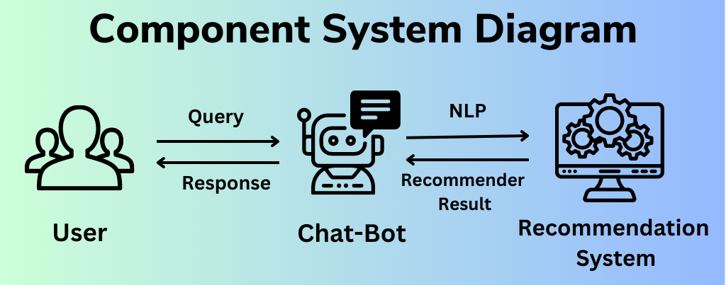
Methodology
IT20225506 | THIRIMANNE S.U | TMP – 23 – 283

Slide 14

Functional Requirements
Non-Functional Requirements
Accurately identify the information related to the query given by user.
Less response time
High process speed
High capacity
Consider emotions and personalization into account.
Reliability
Realtime
Availability
User-friendliness
Efficiency
IT20225506 | THIRIMANNE S.U | TMP – 23 – 283

Slide 15
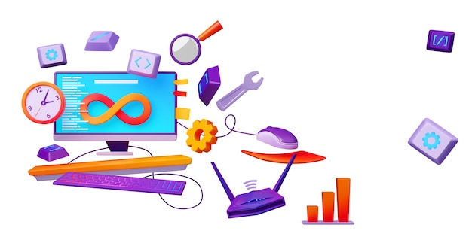
Tools & Technology (Proposed)
Technology Stack
  Version Controlling System - GitHub
Tools
  Database: MongoDB
  Backend: Python/Flask
  Front End: Preact
  Deployment/Cloud Platform: Google Cloud Platform
Algorithms
  BERT & Pytorch / Rasa NLU
IT20225506 | THIRIMANNE S.U | TMP – 23 – 283

Slide 16
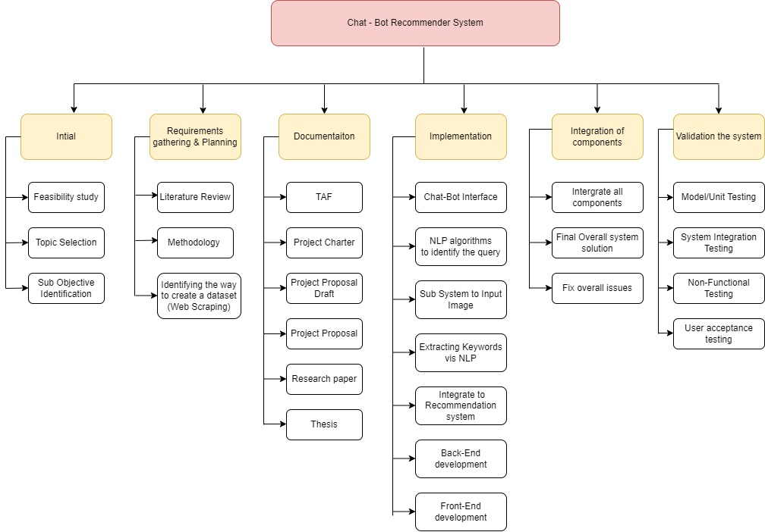
Work Breakdown Structure
IT20225506 | THIRIMANNE S.U | TMP – 23 – 283

Slide 17
References
[1] – Caldarini, G., Jaf, S. and McGarry, K. (2022) A literature survey of recent advances in Chatbots, MDPI. Multidisciplinary Digital Publishing Institute. Available at: https://www.mdpi.com/2078-2489/13/1/41#B28-information-13-00041.
[2] - Nimavat, K. and Champaneria, T. (2017) Chatbots: An overview. types, architecture, tools and future possibilities. Available at: https://www.researchgate.net/publication/320307269_Chatbots_An_overview_Types_Architecture_Tools_and_Future_Possibilities.
[3] - Chandrasena, W. (2020) Sinhala Chatbot with Recommendation System for Sri Lankan Traditional Dancers. Available at: http://ir.kdu.ac.lk/bitstream/handle/345/5205/8.pdf?sequence=1.
[4] - I-Ching Hsu and An-Hung Liao (2022) Sentiment-based Chatbot using Machine Learning for Recommendation System. Available at: https://assets.researchsquare.com/files/rs-1468604/v1_covered.pdf?c=1661357776.
[5] - Shaikh, A., Patil, B. and Sonawane, T. (2021) A machine learning based chatbot song Recommender System - JETIR. Available at: https://www.jetir.org/papers/JETIR2112328.pdf.
IT20225506 | THIRIMANNE S.U | TMP – 23 – 283

Slide 18
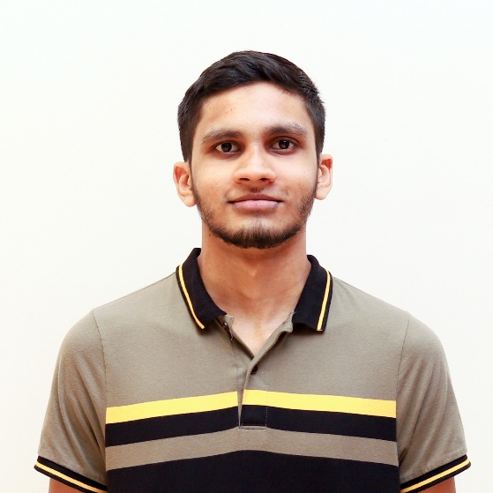
M.U. Amanullath | IT20155520
B.Sc. (Hons) Degree in Information Technology Specialized in Data Science
IT20155520 | M.U. Amanullath | TMP-23-283

Slide 19

Research Question
How can you get suggestions through
a chat bot to improve your current PC
setup if you do not know the current
components of your PC?
IT20155520 | M.U. Amanullath | TMP-23-283

Slide 20

Research Gap
While the existing work demonstrates how to implement object detection [1][2], it does not specifically address the identification of computer hardware components. There is a need for a specialized approach to accurately and efficiently identify computer hardware components in near real-time.
IT20155520 | M.U. Amanullath | TMP-23-283

Slide 21

Specific Objectives
The objective of this component is to develop a near-real-time computer hardware identification system that can accurately identify computer hardware components (mainly RAM and storage).
Integrate the object detection algorithm with a chat bot interface for real-time identification and user interaction.
IT20155520 | M.U. Amanullath | TMP-23-283

Slide 22

Sub Objectives
Collect images of computer hardware components and label them using appropriate labeling tools.
Train and evaluate YOLO, Faster R-CNN, and Faster SqueezeNet object detection algorithms on the labeled dataset.
Modify the object detection algorithm to improve accuracy and reduce processing time.
Integrate the object detection algorithm with the chat bot interface for real-time identification and user interaction.
IT20155520 | M.U. Amanullath | TMP-23-283
Notes:
YOLO: YOLO stands for "You Only Look Once." It's an object detection algorithm that can quickly identify objects in an image and label them with a bounding box. It's called "You Only Look Once" because it only needs to analyze an image once to detect objects, unlike other algorithms that may need to analyze an image multiple times. This makes it a very fast and efficient algorithm for object detection.
Faster R-CNN: Faster R-CNN stands for "Faster Region-based Convolutional Neural Network." It's another object detection algorithm that uses a combination of a convolutional neural network (CNN) and region proposal network (RPN) to identify objects in an image. Essentially, it first generates potential regions in an image where objects may be located, and then uses the CNN to identify and label objects within those regions. It's a very accurate algorithm, but can be slower than YOLO.
Faster SqeezeNet: Faster SqeezeNet is similar to Faster R-CNN in that it also uses a CNN to identify objects in an image. However, it's different in that it uses a smaller and more efficient CNN architecture called SqeezeNet. This makes it faster than Faster R-CNN, but potentially less accurate.

Slide 23
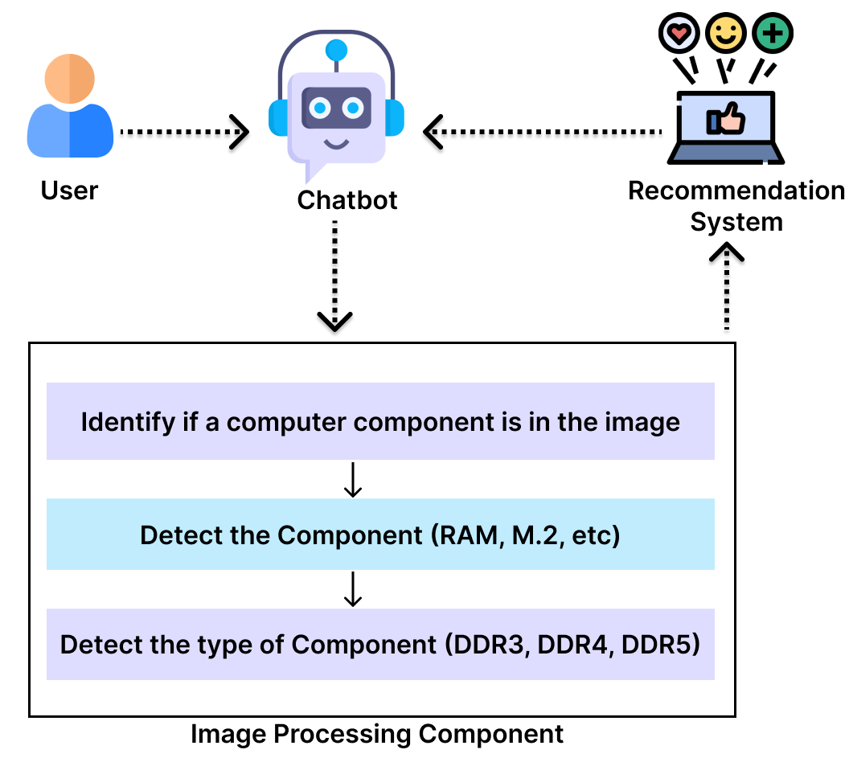
Methodology
IT20155520 | M.U. Amanullath | TMP-23-283

Slide 24
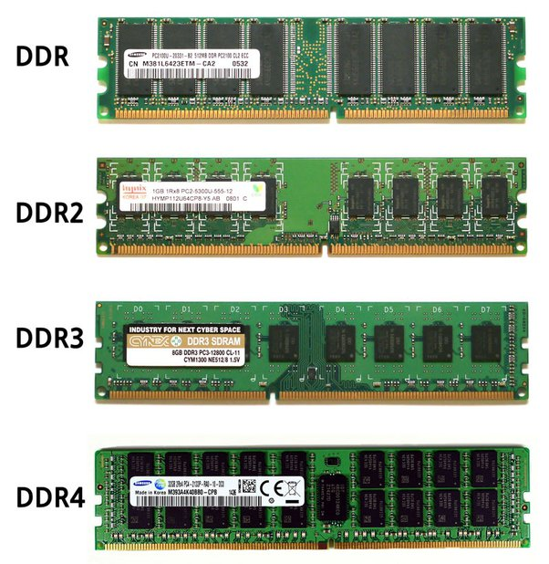
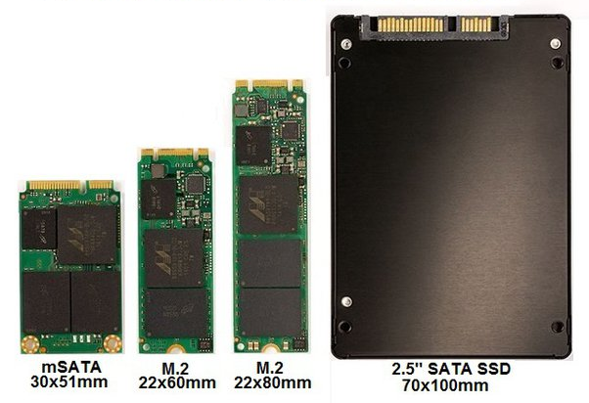
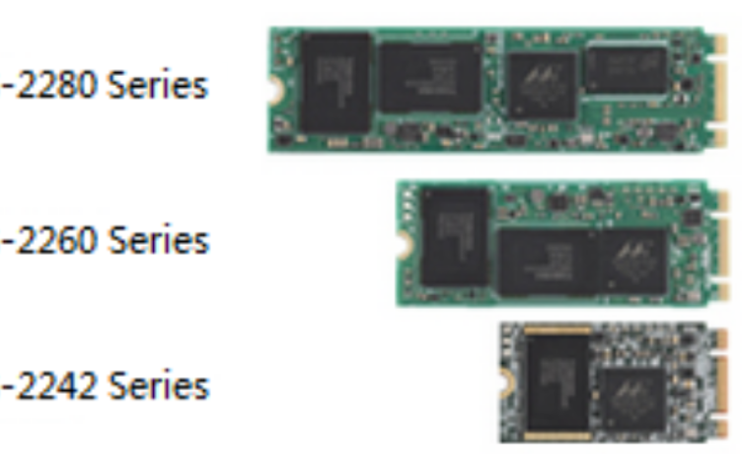
Methodology
Sizes of M.2s
Types of Storage
Types of RAM
IT20155520 | M.U. Amanullath | TMP-23-283

Slide 25




Tools and Techniques
Programming Languages:
Python
Tools:
Labeling images - LabelImg tool
Google Colab, Visual Studio Code
Technology stack:
Version controlling-GitHub
Algorithm:
R-CNN
or
YOLO (You Only Look Once) Algorithm – Object detection
IT20155520 | M.U. Amanullath | TMP-23-283

Slide 26
Requirements
Functional requirements:
Ability to accurately identify computer hardware components.
Ability to identify multiple hardware components in a single image.
Non-Functional Requirements:
Accuracy
Near-real time processing time
IT20155520 | M.U. Amanullath | TMP-23-283

Slide 27
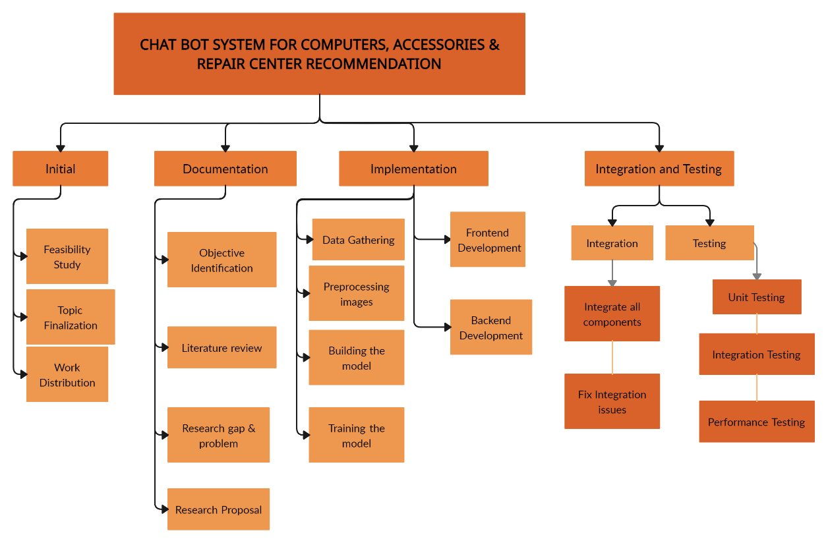
Work Breakdown Structure
IT20155520 | M.U. Amanullath | TMP-23-283

Slide 28
REFERENCES
[1] A. Rosebrock, YOLO object detection with OpenCV, 12-Nov-2018. [Online]. Available: https://pyimagesearch.com/2018/11/12/yolo-object-detection-with-opencv/ [Accessed: Mar-2023].
[2] Girshick, R.; Donahue, J.; Darrell, T.; Malik, J. Rich feature hierarchies for accurate object detection and semantic segmentation, 2014. Available: https://www.cv-foundation.org/openaccess/content_cvpr_2014/papers/Girshick_Rich_Feature_Hierarchies_2014_CVPR_paper.pdf [Accessed: Mar-2023].
IT20155520 | M.U. Amanullath | TMP-23-283

Slide 29
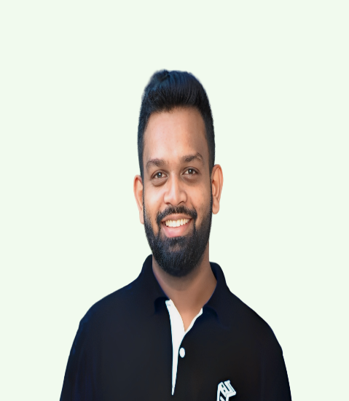
IT20237554 | Rathnaweera r.p.w.g
B.Sc. (Hons) Degree in Information Technology Specialized in Data Science
IT20237554 | Rathnaweera R.P.W.G| TMP-23-283

Slide 30

SPEECH TO TEXT RECOGNITION SYSTEM
Research Question
How can product and repair center reviews be extracted comprehensively from all media types?
IT20237554 | Rathnaweera R.P.W.G| TMP-23-283
Notes:
Basic requirement is to gather data for the recommendation model so to gather data from all kind of platforms (online forums, videos and ect)

Slide 31


Research Gap
Application Reference | Usage of Speech to text system for computer & computer accessories domain | Integration of Sentiment analysis and deep learning with Speech to text system | application of Hybrid Methodologies
Research [1] A knowledge-based recommendation system
Research [2] Convolutional Neural Networks for speech recognition
Research [3] Deep Learning based semantic personalized recommendation system
Proposed System
Filtering and sorting techniques can be frequently seen in Sri Lankan websites but collecting product reviews through platforms like YouTube using speech-to-text systems and recommending a device to the user is a unique feature.
integration of sentiment analysis and deep learning techniques in the chat-bot system to improve the accuracy and personalization of the recommendations
Hybrid approach of different methodologies can be used to implement the system
IT20237554 | Rathnaweera R.P.W.G| TMP-23-283
Notes:
Research 1 - A Knowledge-Based Recommendation System That Includes Sentiment Analysis and Deep Learning
Research 2 - Convolutional Neural Networks (CNNs) for speech recognition which tries to prove that CNN which is more excellent in performance in image processing can also be used for speech recognition tasks due to local capture patterns and ability to train large amount of data
Research 3 - Deep Learning-based Semantic Personalized Recommendation System, deep learning techniques can be used to improve the performance of this system consists of two main components: (1) a feature extractor, which is responsible for extracting useful features from the input data, and (2) a recommender, which uses the extracted features to generate personalized recommendations The feature extractor uses a Deep Learning model based on Convolutional Neural Networks (CNNs) and Recurrent Neural Networks (RNNs) to extract semantic features from the input data, which includes textual, visual, and contextual information.

Slide 32

Specific and Sub Objectives
Main Objective
Data gathering from different sources and implementing a dataset
Development of a speech-to-text recognition system.
IT20237554 | Rathnaweera R.P.W.G| TMP-23-283

Slide 33
Specific and Sub Objectives
Sub Objective
Identification of websites to be Scraped.
Preprocessing of Scraped data.
Identification Speech recognition algorithms and Machine Learning Models
Identification of language and domain on speech data
Collection of Speech data for model training
Evaluation Matrices to evaluate the system
IT20237554 | Rathnaweera R.P.W.G| TMP-23-283
Notes:
Pre-processing - Once you have scraped the data, you need to clean and process it to ensure that it is accurate and consistent. This could involve removing duplicates, correcting errors, and formatting the data.
Speech recognition algorithms and models –
Types of methodologies- HMM(Hidden Markov Model) , DNN(Deep Neural Network), CNN (Convolutional Neural Network), RNN(Recurrent Neural Network), Hybrid Models
Using both deep neural networks (DNN) and recurrent neural networks (RNN). DNNs would be useful for processing the video reviews, extracting features, and generating speech-to-text transcriptions. Meanwhile, RNNs can be used to process the transcriptions and analyze the text for sentiment and meaning, helping the chatbot to make appropriate recommendations. Using a hybrid approach that combines DNNs and RNNs would allow for the processing and analysis of both video reviews and text data
Advantages of using RNN and DNN – Improving the accuracy by combining different methodologies ,Better feature extraction, Robustness to noise and variability – with the combination can be used to robust to noise and variability in data
Identification of language and domain - models may incorporate domain-specific vocabulary and language models to improve the accuracy of the speech-to-text system. For instance, a speech-to-text system designed for computer accessories recommendation may use computer details related vocabularies and dictionaries
Must collect diverse speech data where to build and robust speech recognition system
commonly used metrics to evaluate the performance of speech-to-text systems are Word Error Rate (WER) and Character Error Rate (CER).
Word Error Rate (WER) measures the percentage of incorrectly recognized words in the transcribed text. (Lower WER rate higher accuracy)
Character Error Rate (CER) measures the percentage of incorrectly recognized characters in the transcribed text. (Lower CER rate higher accuracy)
The most commonly used benchmark dataset for speech-to-text systems is the LibriSpeech dataset,
Comparing the performance of a system with other state-of-the-art systems (Google's Cloud Speech-to-Text API, Amazon Transcribe, and Microsoft Azure Speech Services) using the same dataset and evaluation metrics can provide insights into the system's strengths and weaknesses.

Slide 34
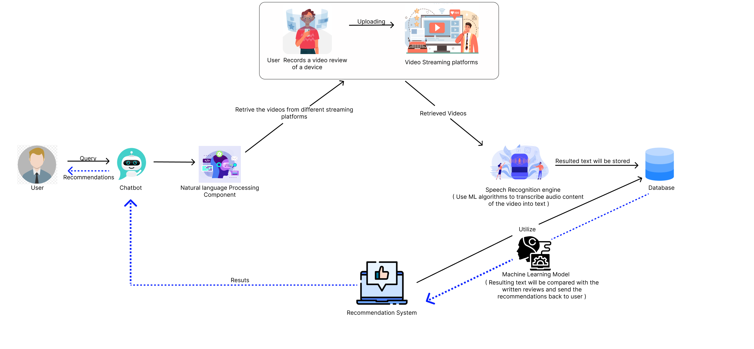
Methodology
Component Diagram
IT20237554 | Rathnaweera R.P.W.G| TMP-23-283

Slide 35




Tools &Technologies
Technologies
  Development – Python
  Building Model – Visual Studio Code, Google Collab
Technology Stack
  Version Controlling - GitHub
Algorithms
  Deep Neural Networks (DNN)
  Recurrent Neural Networks (RNN)
IT20237554 | Rathnaweera R.P.W.G| TMP-23-283

Slide 36

Functional Requirements
Filtering the accurate text
  The system must have the ability to recognize and extract the most accurate text through a speech to text recognition from user generated video reviews.
Storing extracted data and Sentimental analysis
  The system must have the ability to store the transcribe text into the database for future analysis where those extracted text can be used to analyze the vocal tones and patterns to determine the sentiment or emotions towards that
IT20237554 | Rathnaweera R.P.W.G| TMP-23-283

Slide 37

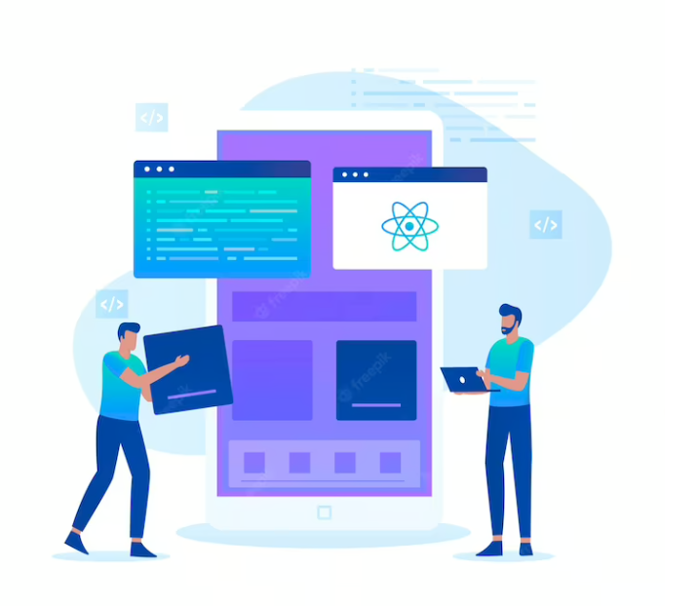

Non-Functional Requirements
Reliability
User-friendliness
Accuracy
IT20237554 | Rathnaweera R.P.W.G| TMP-23-283

Slide 38
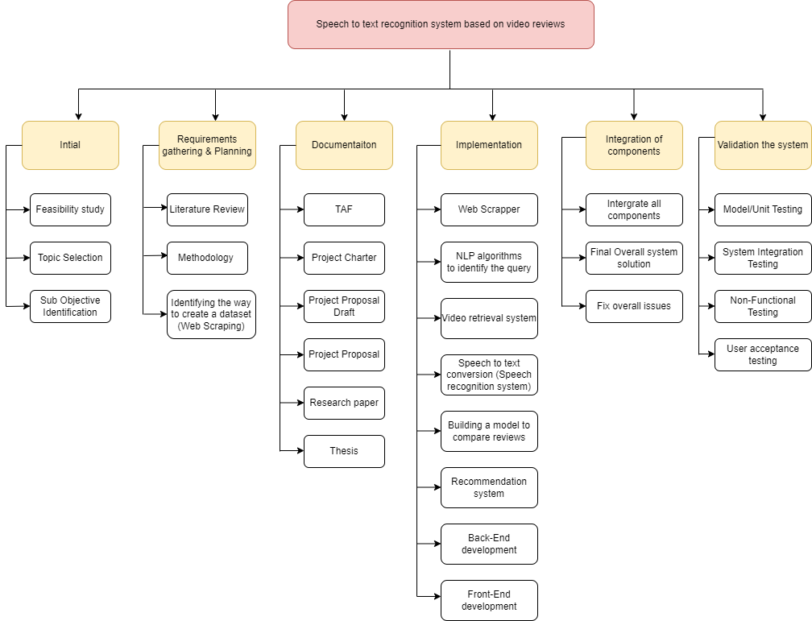
Work Breakdown Structure
IT20237554 | Rathnaweera R.P.W.G| TMP-23-283

Slide 39
References
[1]R. L. Rosa, “A knowledge-based recommendation system that includes Sentiment Analysis and Deep Learning- IEEE Xplore,” 2018. [Online]. Available: https://ieeexplore.ieee.org/document/8445585.
[2] O. Abdel-Hamid, H. Jiang, L. Deng, and G. Penn, “Convolutional Neural Networks for speech recognition ,” 2014. [Online]. Available:
https://ieeexplore.ieee.org/abstract/document/6857341.
[3] S. Sharma, V. Rana, and V. Kumar, “Deep Learning based semantic personalized recommendation system,” International Journal of Information Management Data Insights, 02-Aug-2021. [Online]. Available: https://www.sciencedirect.com/science/article/pii/S2667096821000215.
IT20237554 | Rathnaweera R.P.W.G| TMP-23-283

Slide 40

IT20125998 | h.a.m sENADHEERA
BSc (Hons) in Information Technology specialized in
Data Science
IT20125998 | Minindu Senadheera | TMP-23-283

Slide 41

Background
Usually when someone want to buy an electronic device especially smart devices a techy person would at least do some research on the device for a week, this include
finding a device matches to him
Watch reviews on the device in YouTube, social media and other websites
Compare the specification with other similar devices
For a person with low technical background this is a challenging process, first thing he would do is get advice from one of his friend. Goal of our chat bot is to be that friend!
IT20125998 | Minindu Senadheera | TMP-23-283

Slide 42
Research Gap
The majority of the suggested laptop recommendation systems prioritize user preferences and laptop features over external criteria like price, brand image, and available shops to buy.
Although user preferences and laptop functionalities can change over time, few studies take this into account when recommending laptops. To create recommendation systems that can vary as user preferences and laptop features do, more study is required.
Several of the studies lacked through analysis of real-world datasets regarding repair centers. To evaluate the performance and usability of these technologies in real-world contexts, additional study is required.
Research gap | Existing Systems | Proposed System
Doesn’t consider external factors like budget, availability |  | ✅
User preference, availability, prices, requirements change overtime |  | ✅
Model trained through real world datasets using actual repair centers |  | ✅
Use multiple algorithms and give the most accurate results set |  | ✅
IT20125998 | Minindu Senadheera | TMP-23-283

Slide 43

Research Problem
How could a person with low technical knowledge find a laptop or computer repair center suits for his needs without the the need of giving his technical requirements?
How well the system understand the user's requirement even in absence of technical data?
IT20125998 | Minindu Senadheera | TMP-23-283

Slide 44
Specific Objective & Sub objectives
Specific Objective
Main objective of this recommendation system is to determine which device & repair center is suitable for the user according to his requirement
Sub Objectives
Preprocess the dataset
Build a content-based recommendation model
Build a collaboration-based recommendation model
Inject parameters / features obtained from NLP & Image processing to the recommendation model
Combine the results from both algorithms and provide the most accurate recommendations
IT20125998 | Minindu Senadheera | TMP-23-283

Slide 45
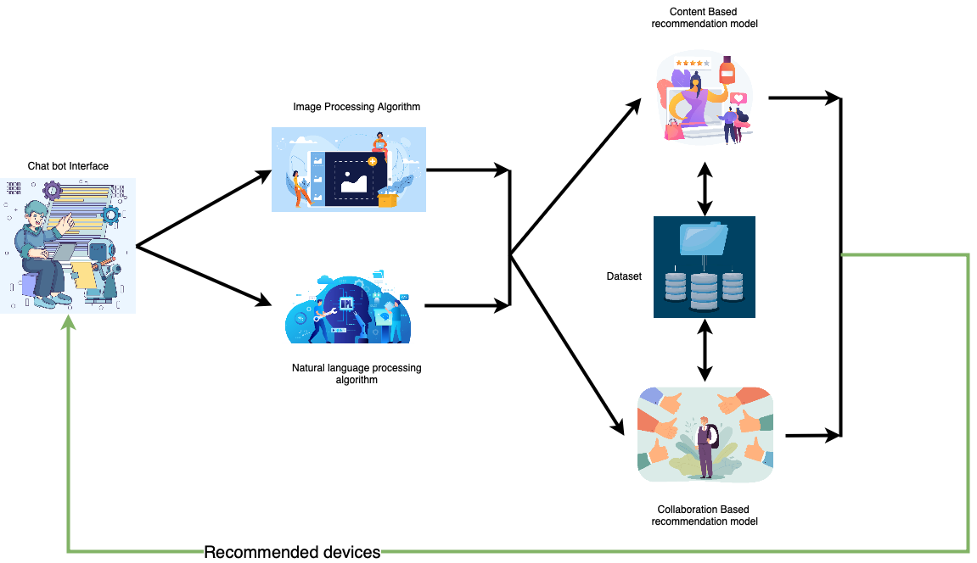
Component diagram
IT20125998 | Minindu Senadheera | TMP-23-283

Slide 46




Tools & Technologies to be used
Programming Languages
Python
Tools
Visual Studio Code
Google Collab
Version controlling – Git & Github
Algorithms
Collaborative filtering
Content based filtering
IT20125998 | Minindu Senadheera | TMP-23-283

Slide 47
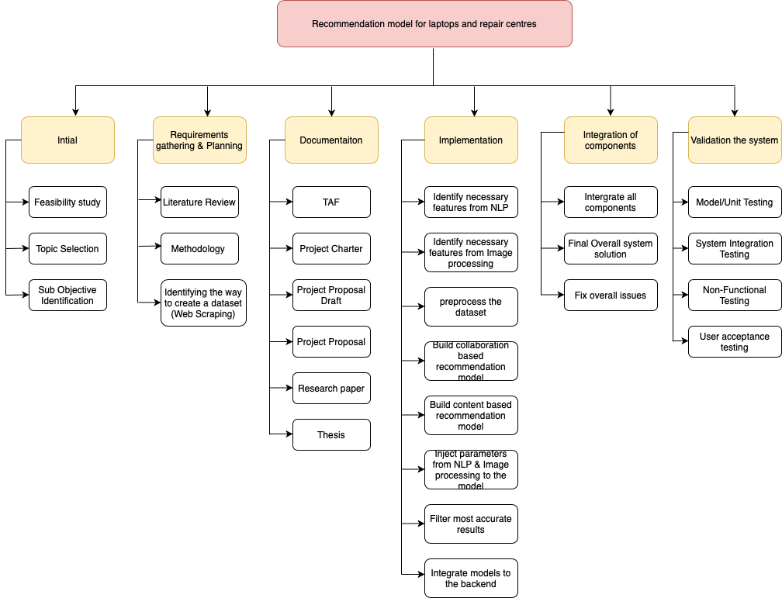
Work Breakdown Structure (WBS)
IT20125998 | Minindu Senadheera | TMP-23-283

Slide 48
References
[1] Hou, Y. and Yang, S. (2022) An e-commerce personalized recommendation algorithm based on fuzzy ..., researchgate.net. Available at: https://www.researchgate.net/publication/360655958_An_E-commerce_Personalized_Recommendation_Algorithm_based_on_Fuzzy_Clustering (Accessed: March 2023).
[2] Govindarajan, P. and Devi, S.S. (2022) Hybrid recommendation system based on collaborative and content-based ..., researchgate. Available at: https://www.researchgate.net/publication/360430232_Hybrid_Recommendation_System_Based_on_Collaborative_and_Content-Based_Filtering (Accessed: March 2023).
IT20125998 | Minindu Senadheera | TMP-23-283

Slide 49

Commercialization
It is initially proposed to commercialize this as a standalone system.
Upon success expecting to market the product towards companies such as Nanotek, Barclays etc. which sells devices, repairs and so on.
CHAT-BOT SYSTEM FOR COMPUTERS, ACCESSORIES & REPAIR CENTER RECOMMENDATION
Commercialization

Slide 50
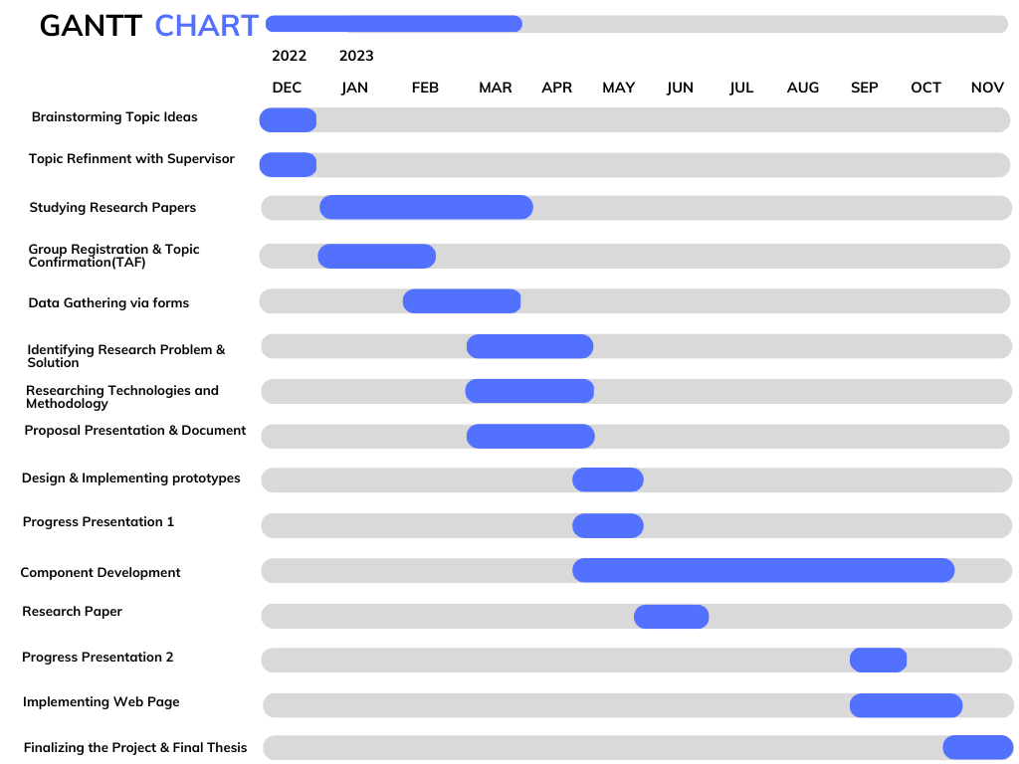
Gantt Chart
CHAT-BOT SYSTEM FOR COMPUTERS, ACCESSORIES & REPAIR CENTER RECOMMENDATION
Gantt Chart

Slide 51

Thank You!

